Slide 1
Data Entry form
A presenation of javafx Application

Slide 2
Introduction
A user-friendly graphical interface.
Integration of input fields, dropdowns, and buttons.
Dynamic data submission and display.
This JavaFX application is designed to collect user data efficiently. The application provides:

Slide 3
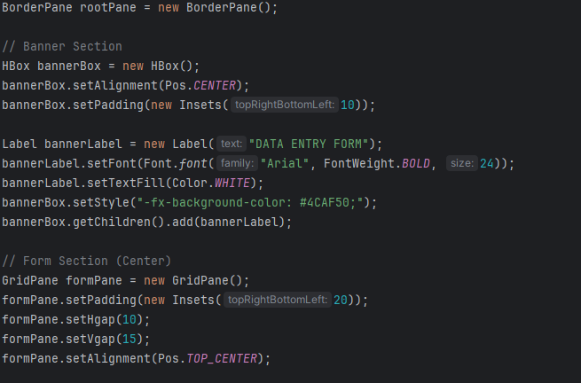
Code Explanation - Part 1
Key aspects of the UI:
*
GridPane layout for organizing fields
*
ComboBox for city selection.
*
Radio buttons for gender selection.

Slide 4
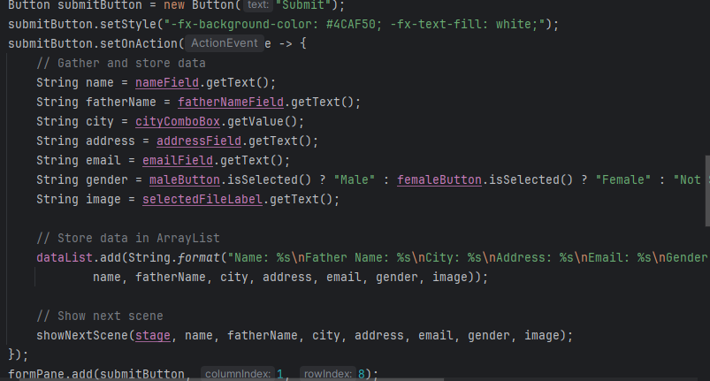
Code Explanation – Part 2
Submit button gathers user inputs.
Validation and storage in an ArrayList.
- Switches between data entry and result screens

Slide 5
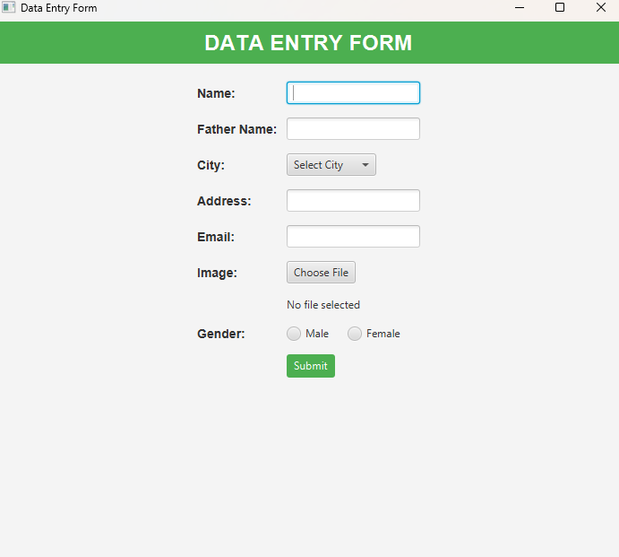
Data Entry Form - UI
====
>
Output screen looks like this:
.

Slide 6
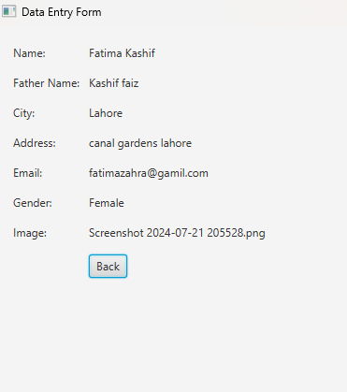
Submitted Details – Output:
Once we submit details it takes us to next scene.
Also save details in an array.
Second scene looks like this:
*
*
*
*
*

Slide 7
Conclusion:
This JavaFX Data Entry Form application demonstrates the integration of a modern UI with data handling. It provides a seamless user experience for collecting and displaying information.

Slide 8
Thank You

